Slide 1
Data Analysis for Eniac
Group 1

Slide 2

Problem Statement
Is to check whether or not it's beneficial to discount products for Eniac based on historical data.
Status Quo
Marketing Team lead is in favor of offering Discounts
Investors are concerned about offering aggressive discounts
Notes:
Recapping on the main depat, whether discounts are beneficial or not.

Slide 3
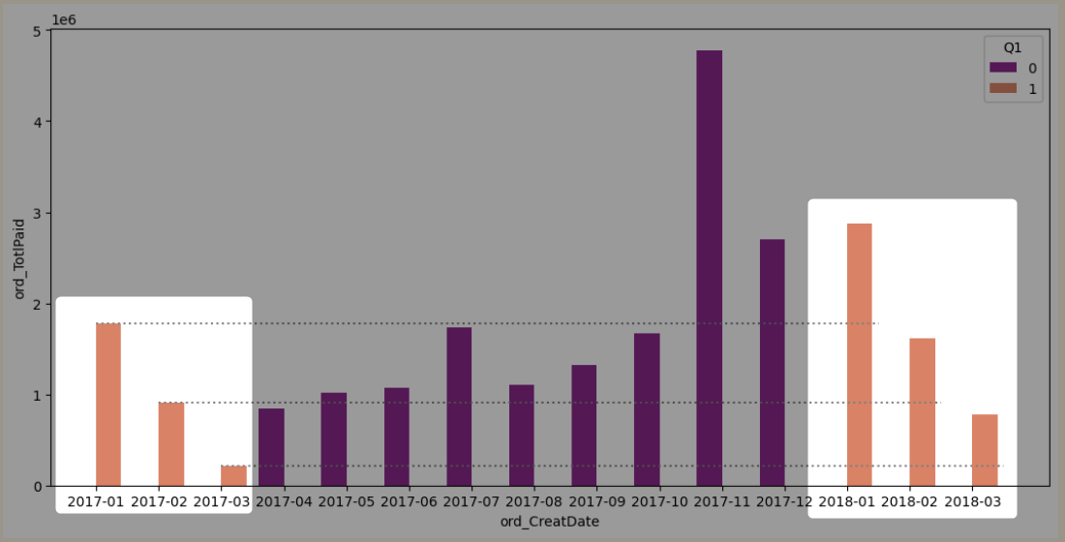
Revenue Increased with Time
Notes:
Taking the main investor concern, regarding the revenue decrease for last quarter of the year,
By looking to the diagram, The Revenue has been decreased for Q1 2018 WRT to Q4 2017
BUT Its not recommended to compare 2 different quarters/months within year with each others But to compare same Quarter of different years to consider seasonal events
Hence looking to Q1 2017, The Revenue as well as number of Orders has been already Increased!!

Slide 4
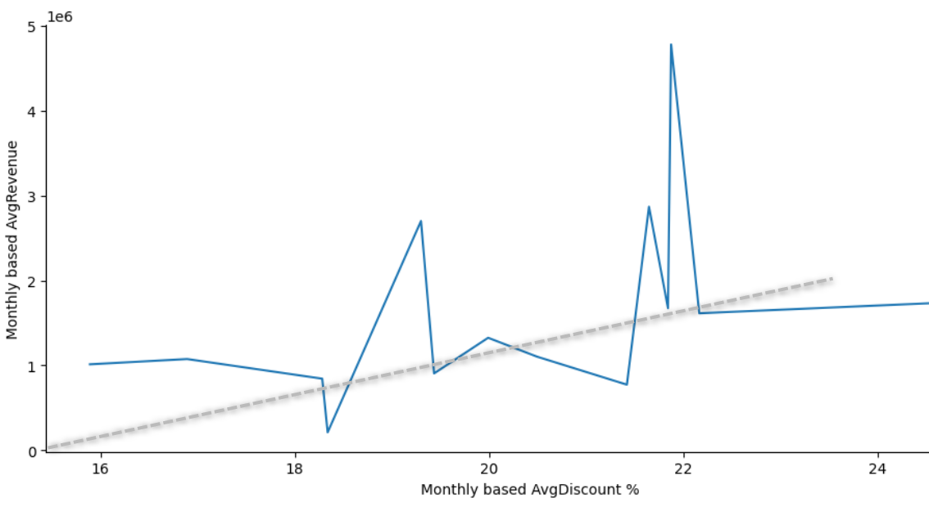
Weak correlation between discount revenue
Notes:
Here is the Avg Revenue vs Avg Discount % calculated monthly based for the all 15 months we have , we can see there is some sort of tendency that show increase in Revenve when discount percent increases.
But while analysing further that exact relation to the products and seasonal event.
We Noticed that the data base has not been developed for such analysis. And hence we prepared some proposals on how to

Slide 5
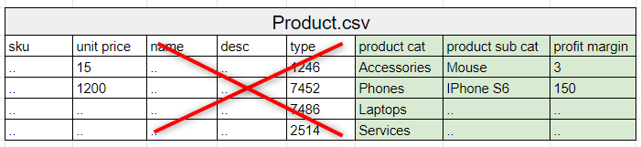
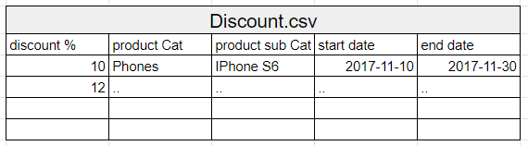
DataBase Improvement proposals
Extend data based timeframe, (min of 2 full years for reliable analysis)
Product Table Enhancement
Separate Discount table

Slide 6
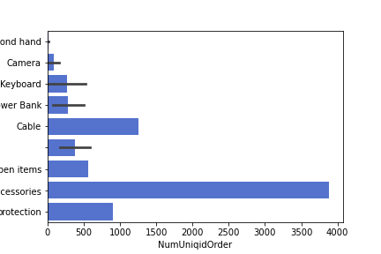
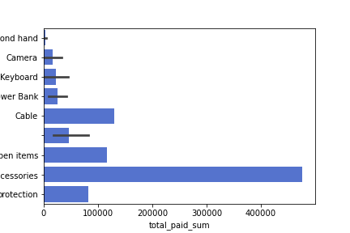
Discount Future Strategy : Bundle Discounts
Second hand
Camera
Keyboard
Power Bank
Cable
Other
Open items
Accessory
Protection
Number unique orders
Second hand
Camera
Keyboard
Power Bank
Cable
Other
Open items
Accessory
Protection
Total paid (sum)

Slide 7
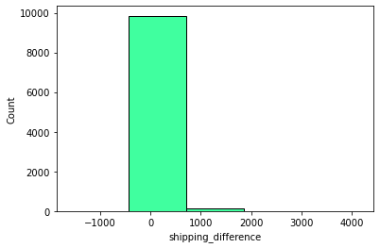
Discount Future Strategy : Free Shipping
Accessory Products are low priced
Shipping Fees sum up to 5-10% of Accessory Products price
Consumers are Four to Five Times more likely to make a Purchase if you Offer Free Shipping.
People are more likely to buy something at $5 with Free Shipping and pass it up at $2.50 with a $2.50 Shipping Fee
Replacing discounts with Free Shipping(Shipping fees included) will be a better market strategy to improve Consumers Acquisition, Satisfaction and Retention.
Notes:
Consumers Are Four to Five Times More Likely to Make a Purchase if You Offer Free Shipping.
People are more likely to buy something at $5 with free shipping and pass it up at $2.50 with a $2.50 shipping fee

Slide 8
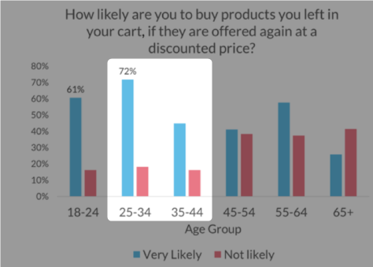
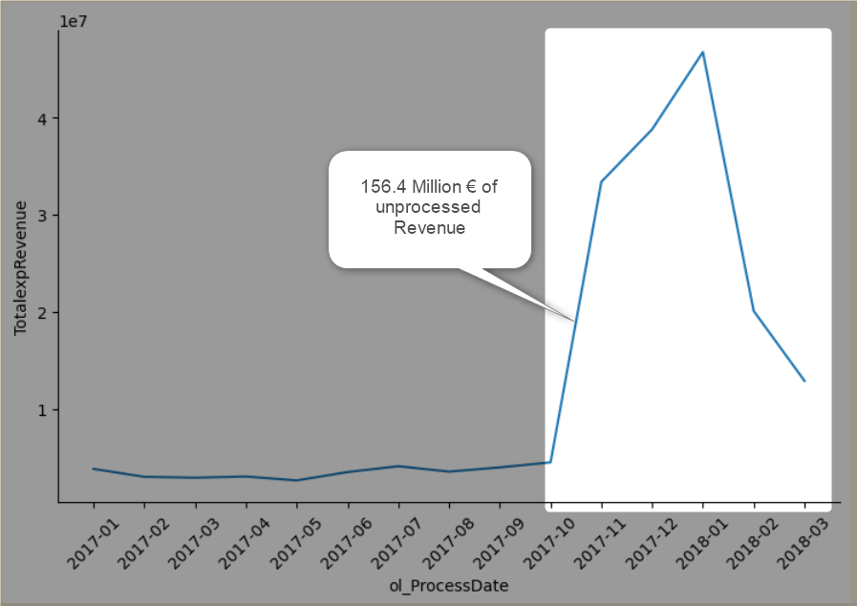
Discount Strategy : Shopping Basket
More than half the orders are in ShopBasket state
Focus on last 6 months, 156.4 M€ of expected Revenue.
Notes:
More Than 50% of the orders are in shopping Basket state, for these we need to use

Slide 9
Appendix

Slide 10
About Eniac
Eniac —the e-commerce tech company specializing in Apple-compatible accessories. It was founded 10 years ago in Spain and it has since grown and expanded to other neighboring countries.
Besides offering a wide catalog of products at competitive prices, Eniac provides friendly and professional tech support and consultation to its customers. The warm hearted spirit that thrives with direct contact with the customers is at the roots of the company.
Key figures
Eg Total revenue, total orders, product count , brand

Slide 11


Key Questions
How products should be classified into different categories to simplify reports and analysis?
What is the distribution of product prices across different categories?
How many products are being discounted?
How big are the offered discounts as a percentage of the product prices?
How seasonality and special dates (Christmas, Black Friday) affect sales?
How could data collection be improved?

